Slide 1
Annotation Automation in Real Imagery
MoCap Image Reprojections Using AprilTag Localization

Slide 2
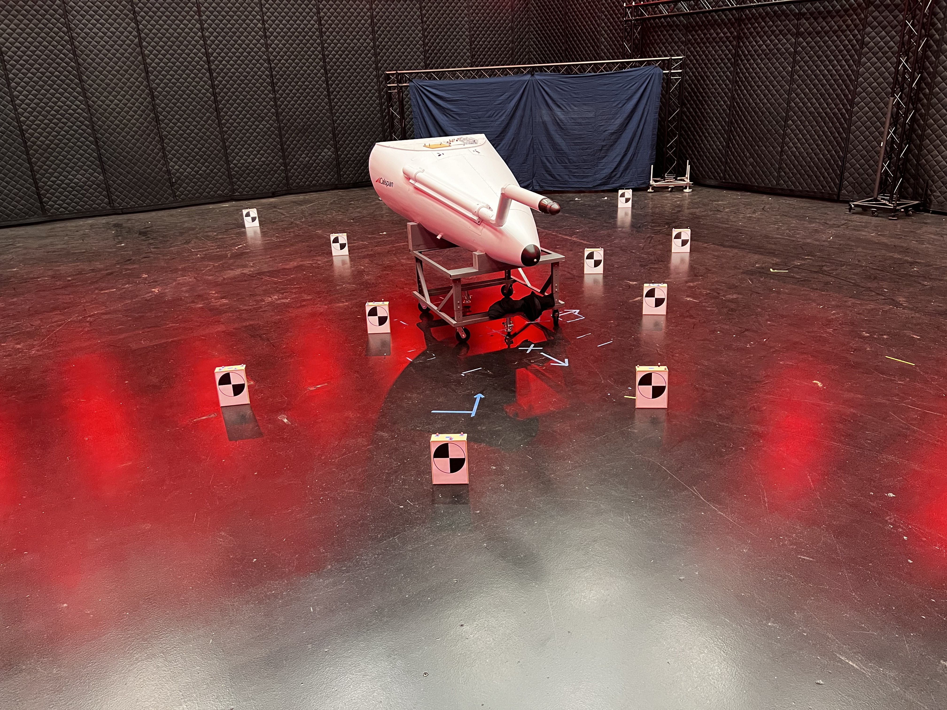

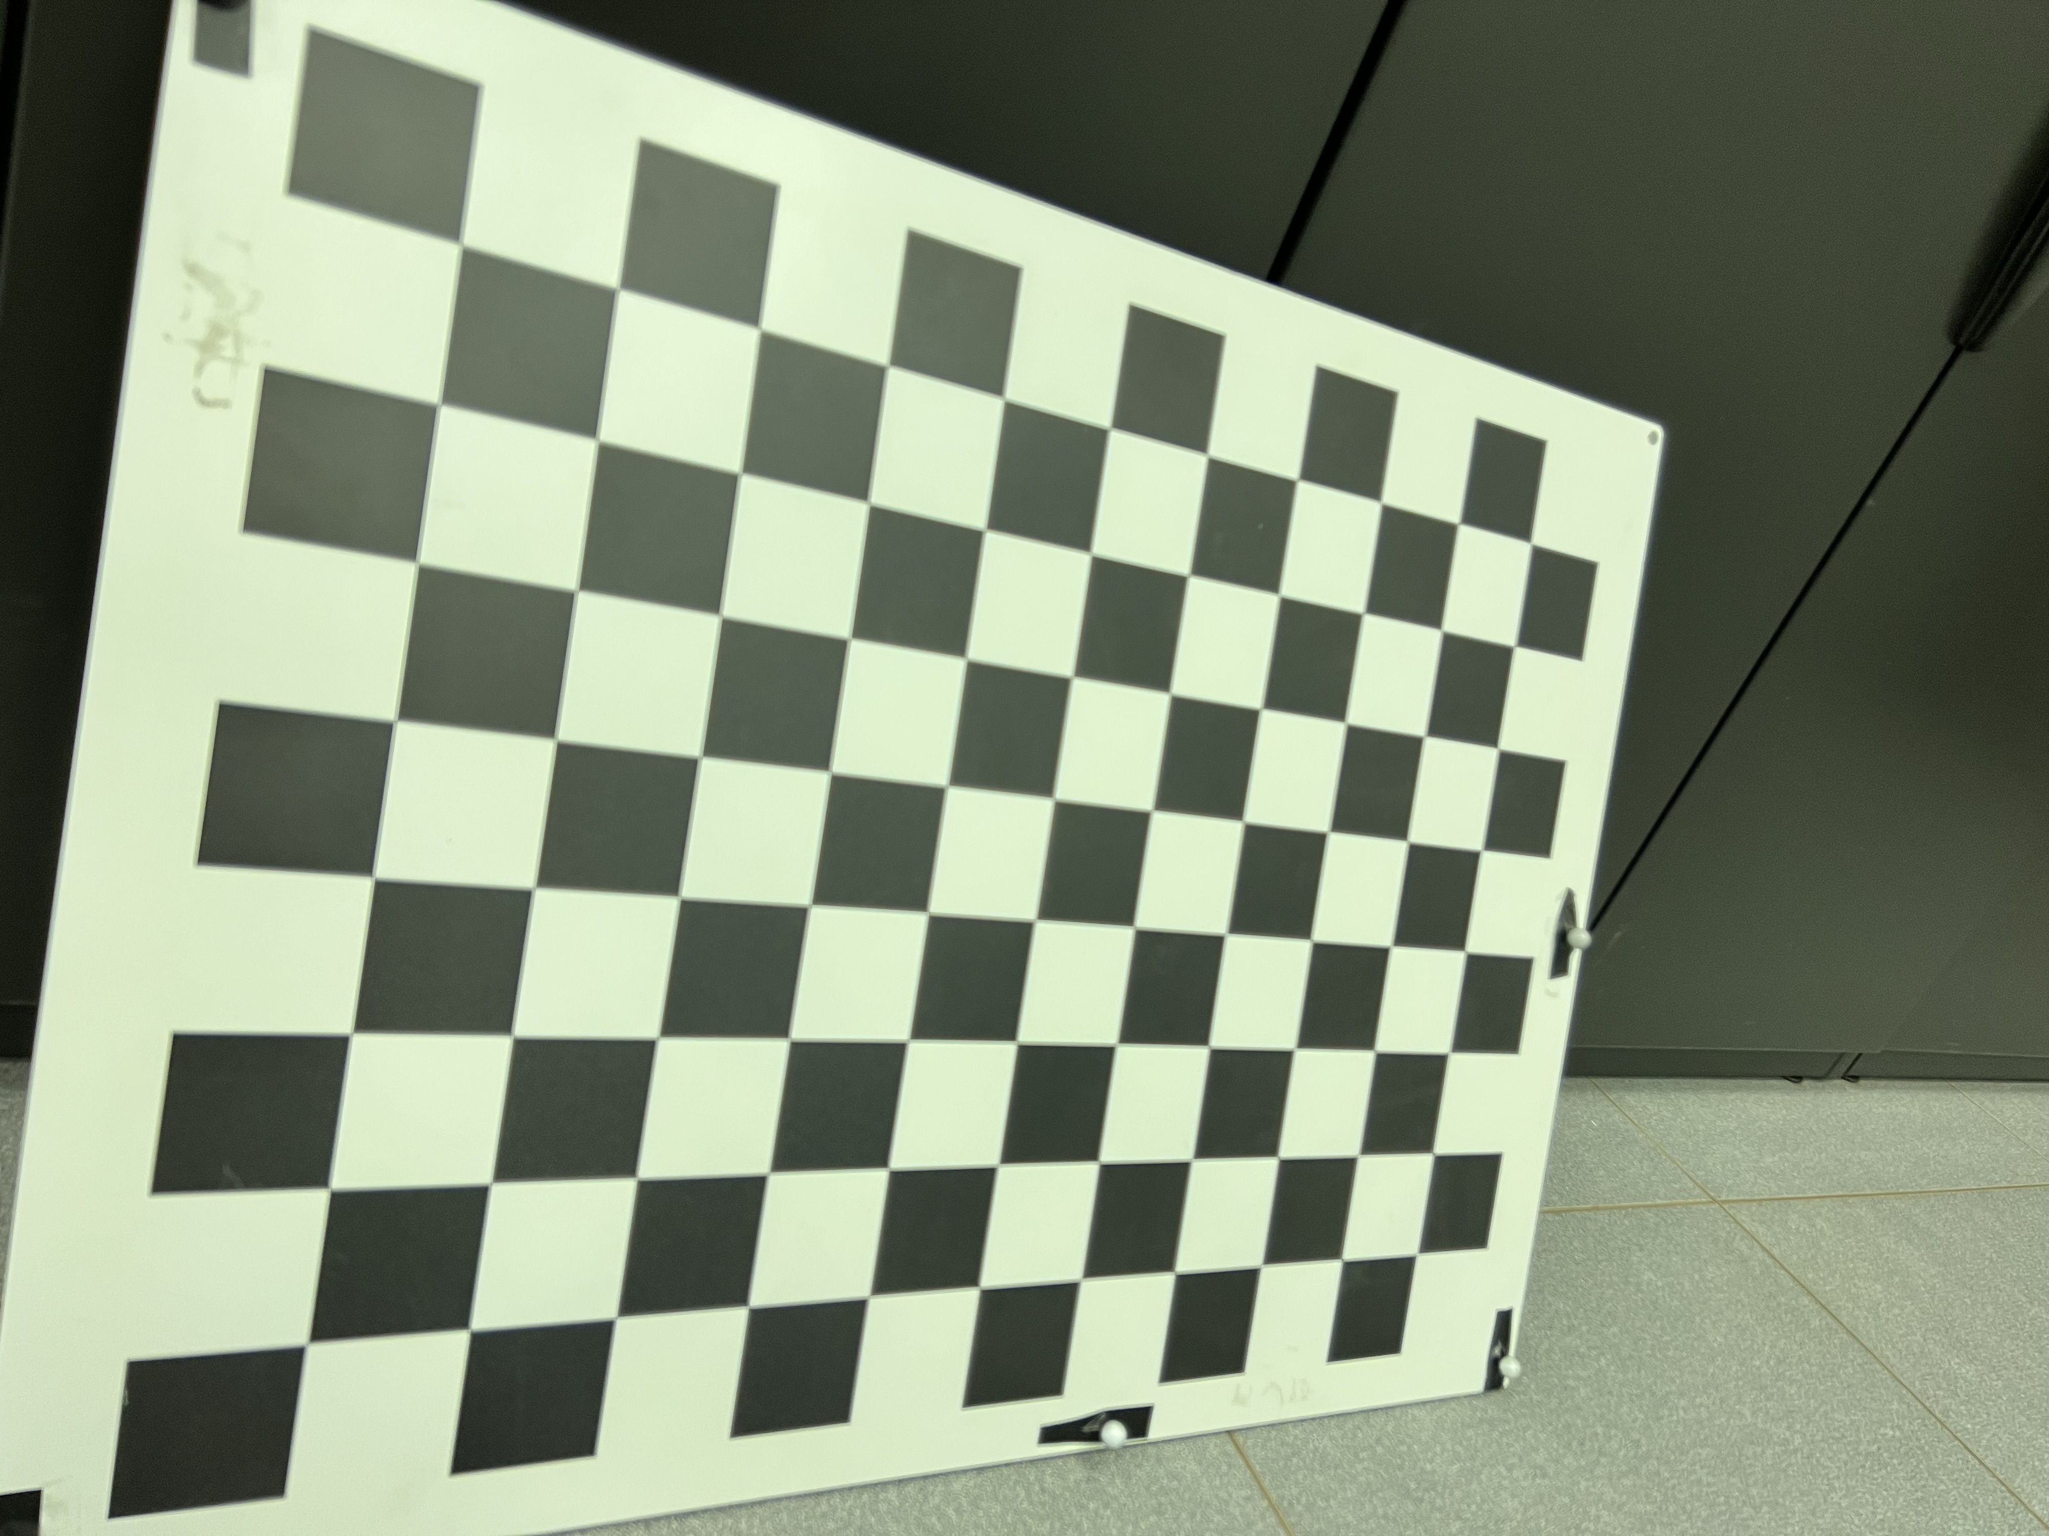
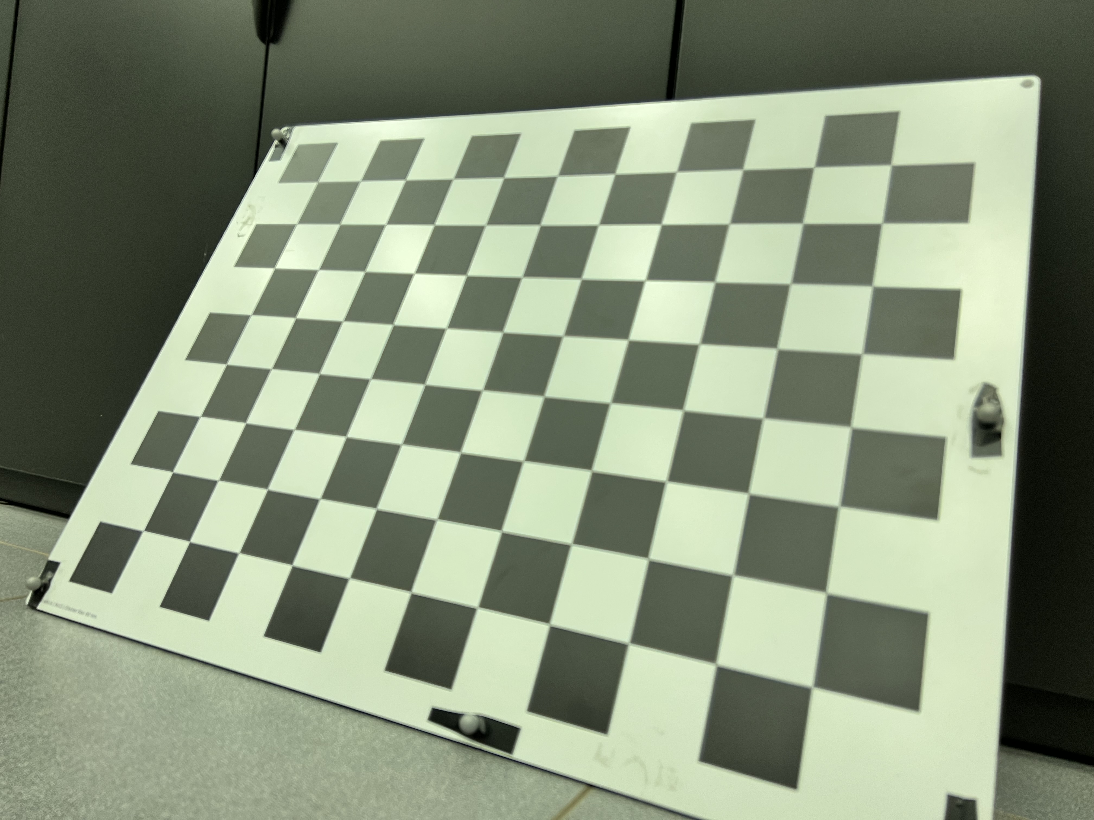
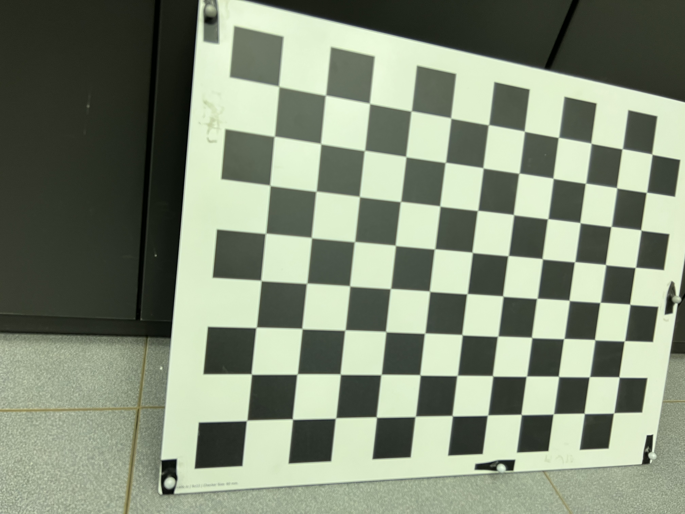
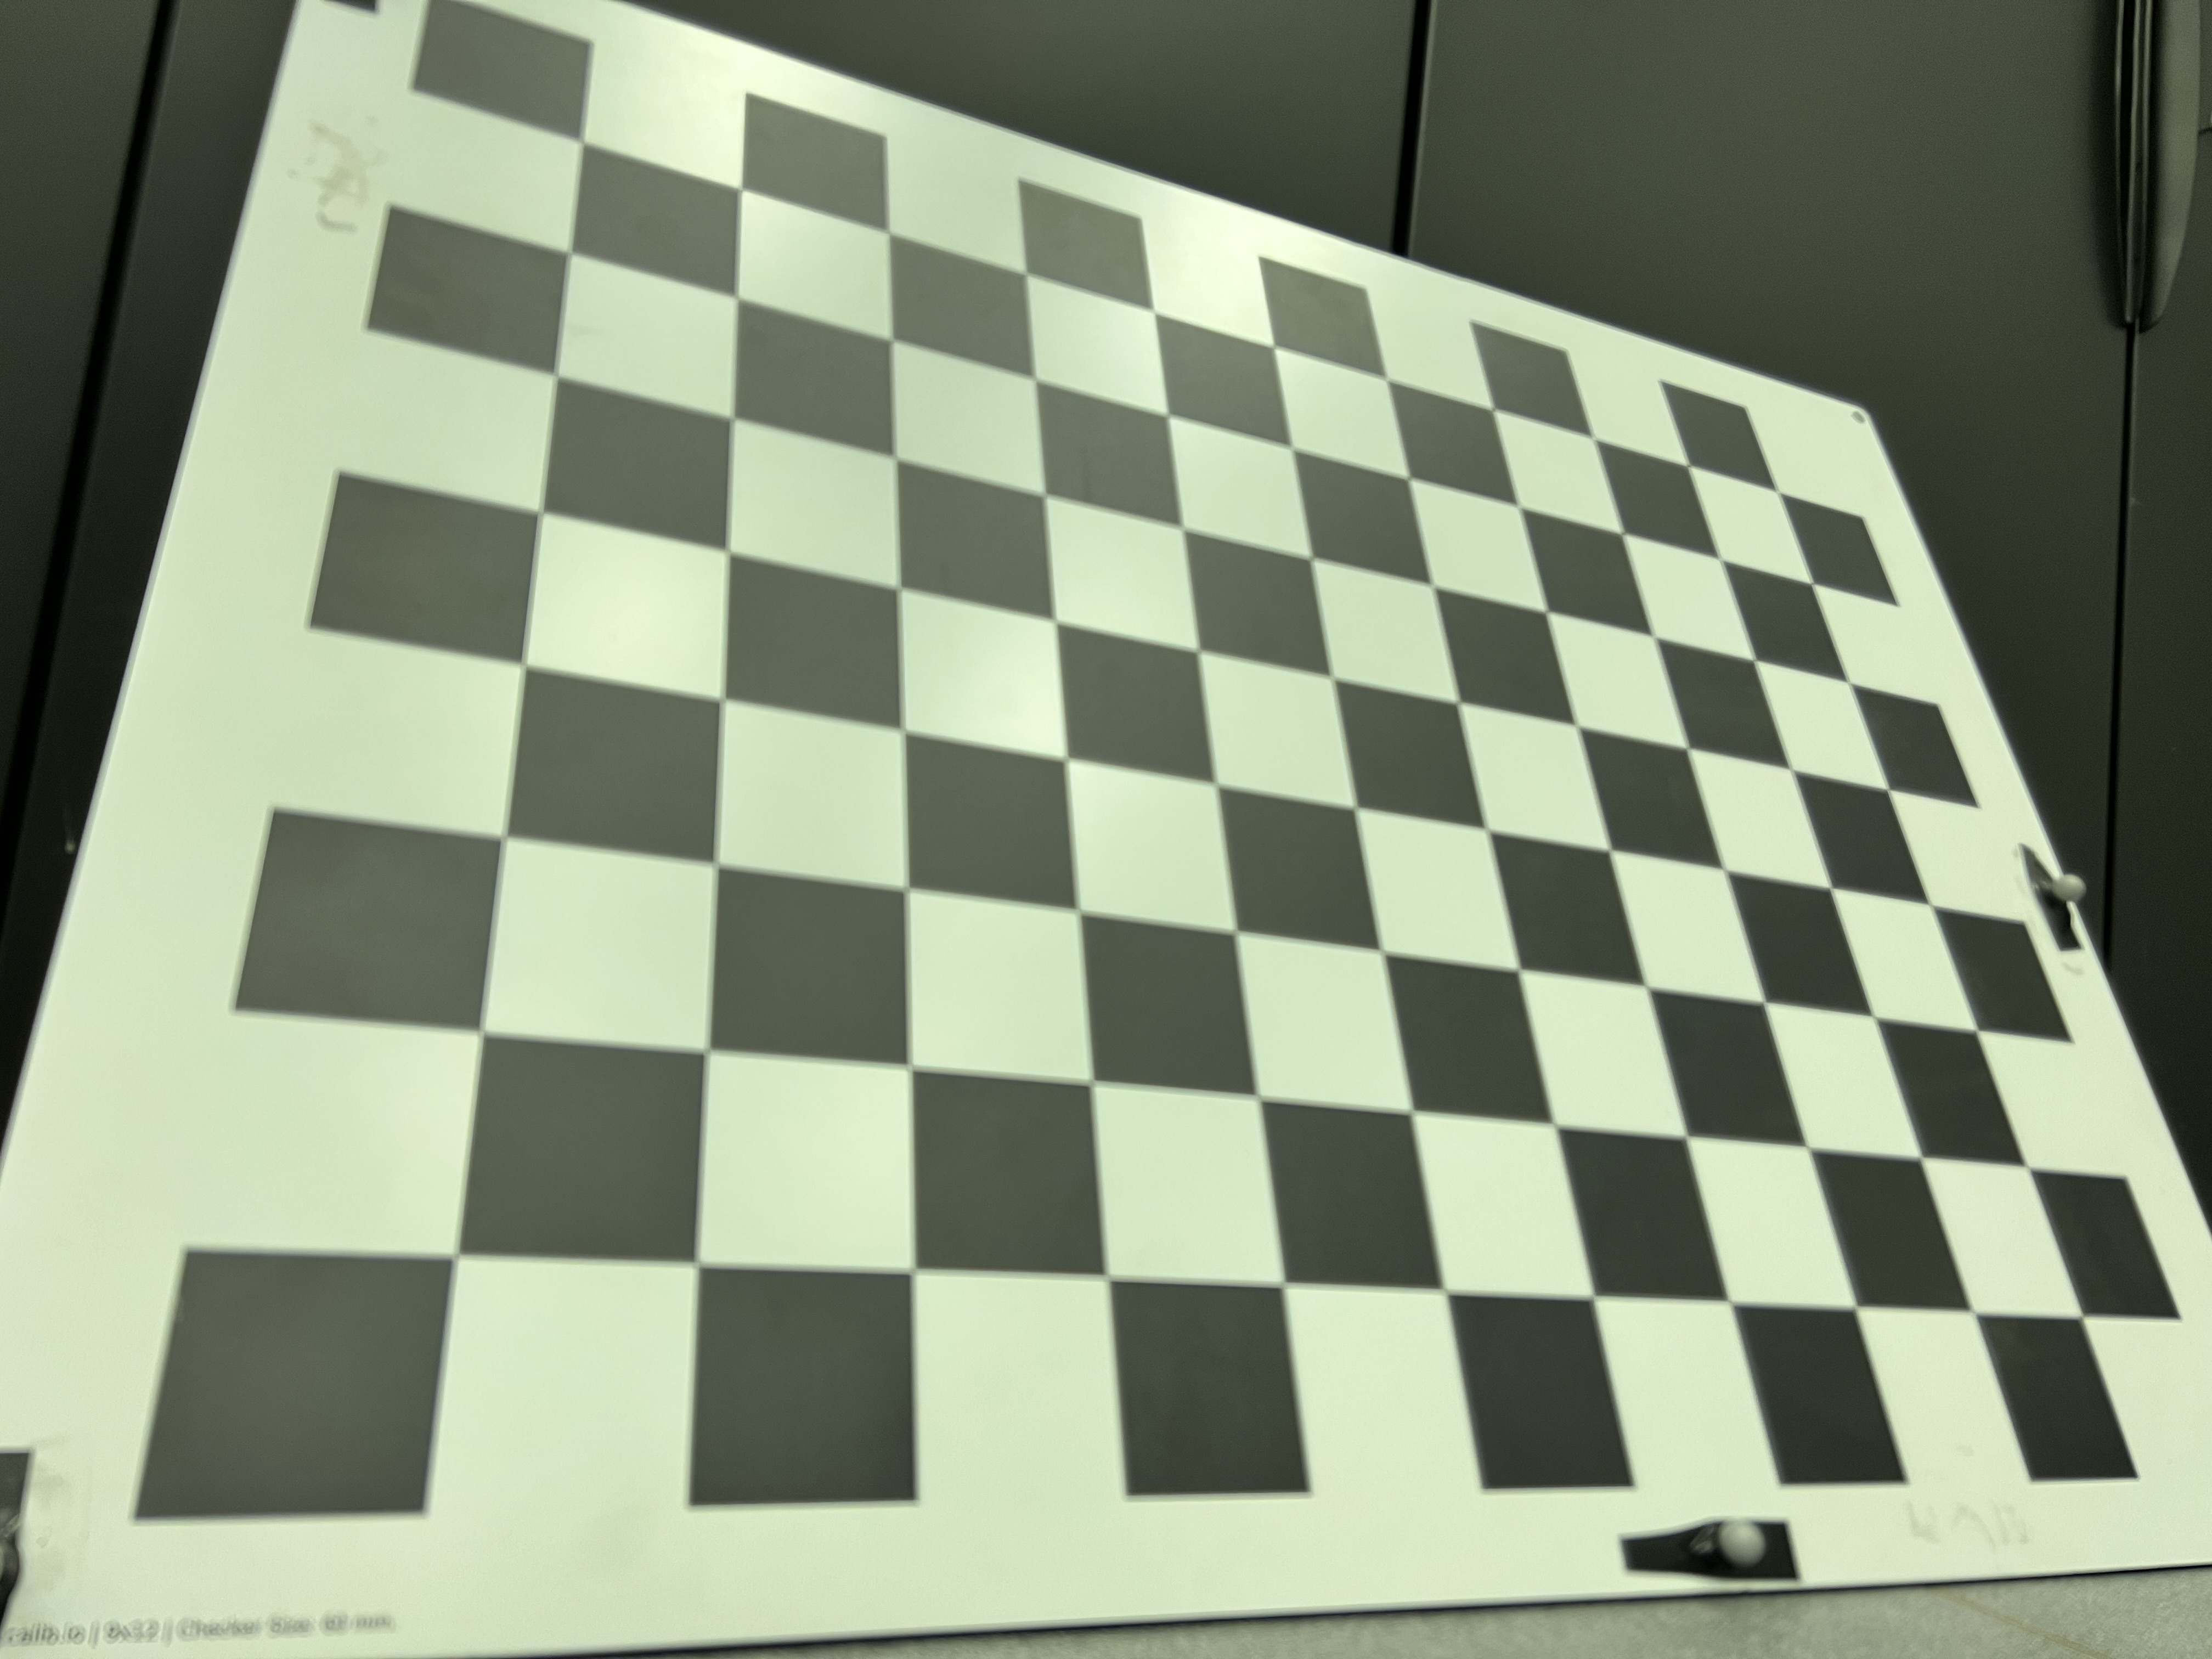
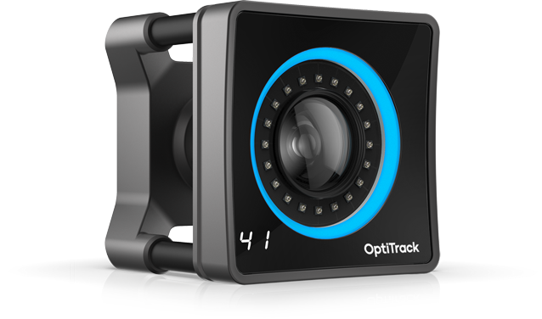

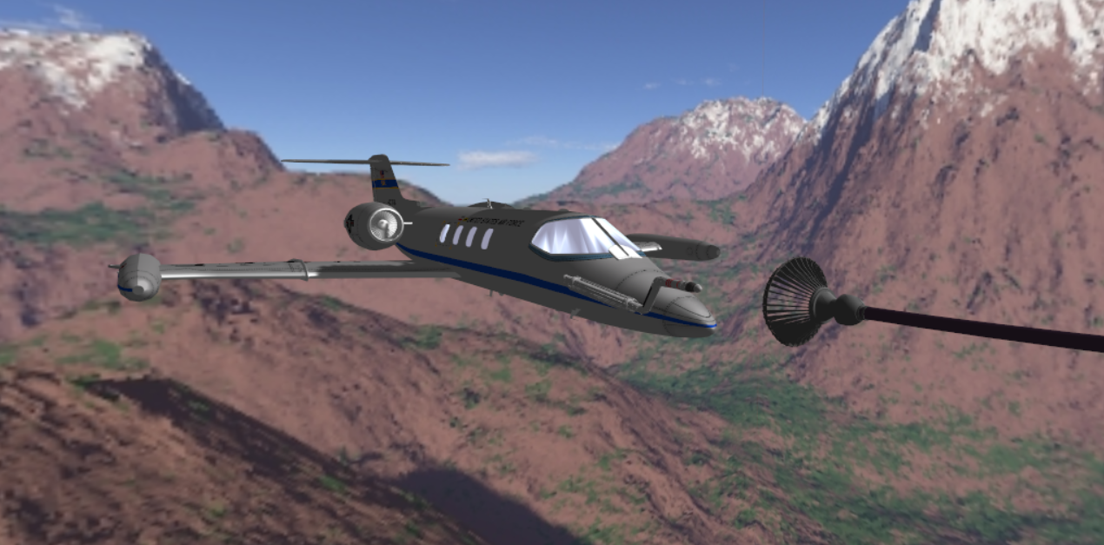
MoCap Image Re-projection
Camera
2D points
Solve
PnP
image capture
3D points
rvec
tvec
Camera Instrinsics
(from chessboard calibration)
Fiducial targets
3D points
marker
balls
Project
Points
marker
balls
3D points
motion capture
Learjet nose cone
MCS
2D points
2D points
2D points
Digital Twin
Reprojections back into
original image

Slide 3
Applying to Real Imagery

Slide 4
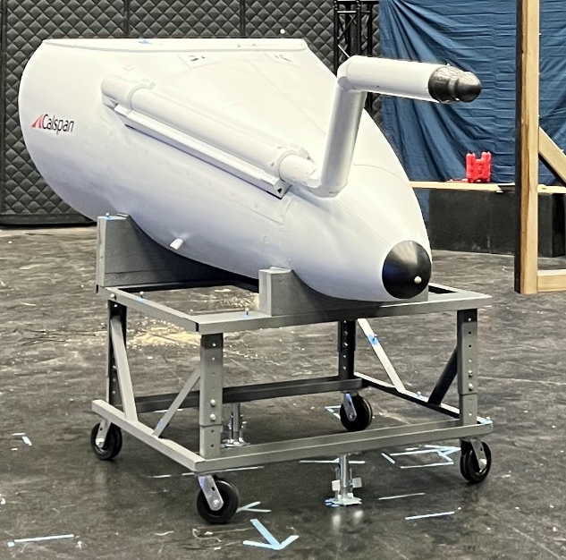
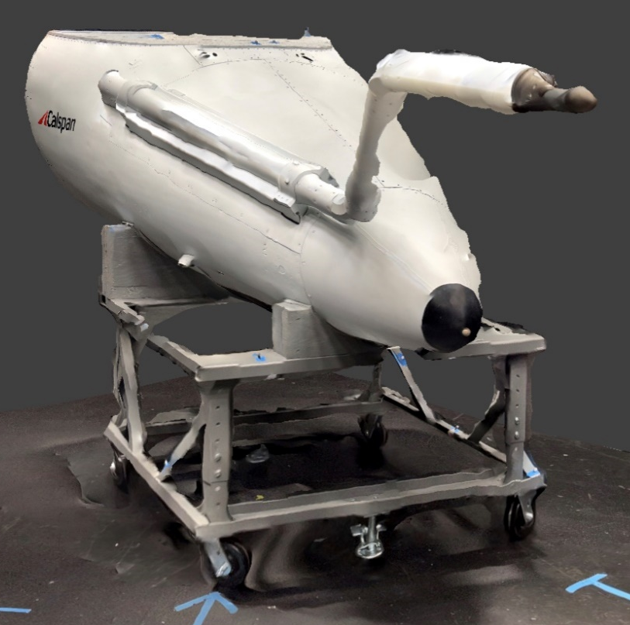
Machine Transfer Learning
Scene Augmentation
Background
Lighting
Perspective
Orientation
Cameras:
Alvium G5 811c
Insta360 Link
Hybrid
(AR)
3D
Scans
Virtual
world
Real
world
MoCap Image
Re-projection
Label Generation
Relative Vectoring
Using predictions on real imagery
Optimize:
Bounding box corrections
Feature selection
Optimize:
Model size
Image input size
Model Training

Slide 5
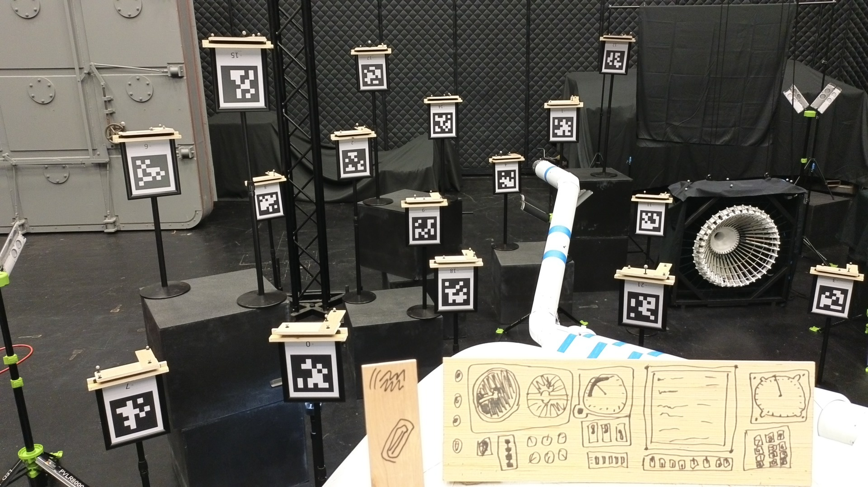

Slide 6
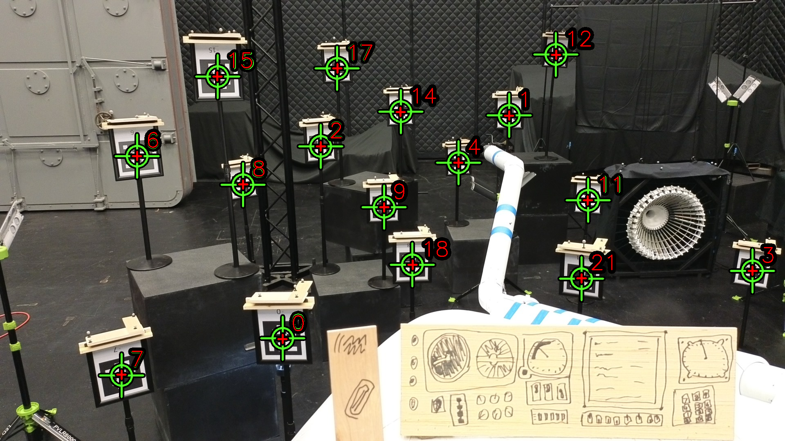

Slide 7
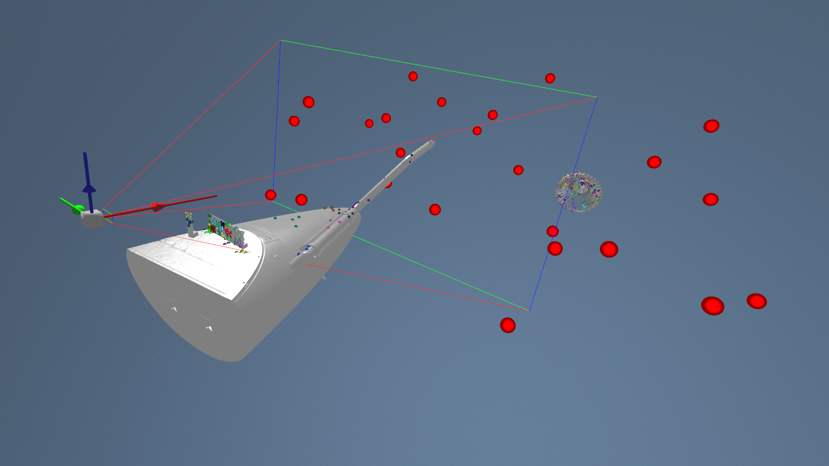
Digital Twin

Slide 8
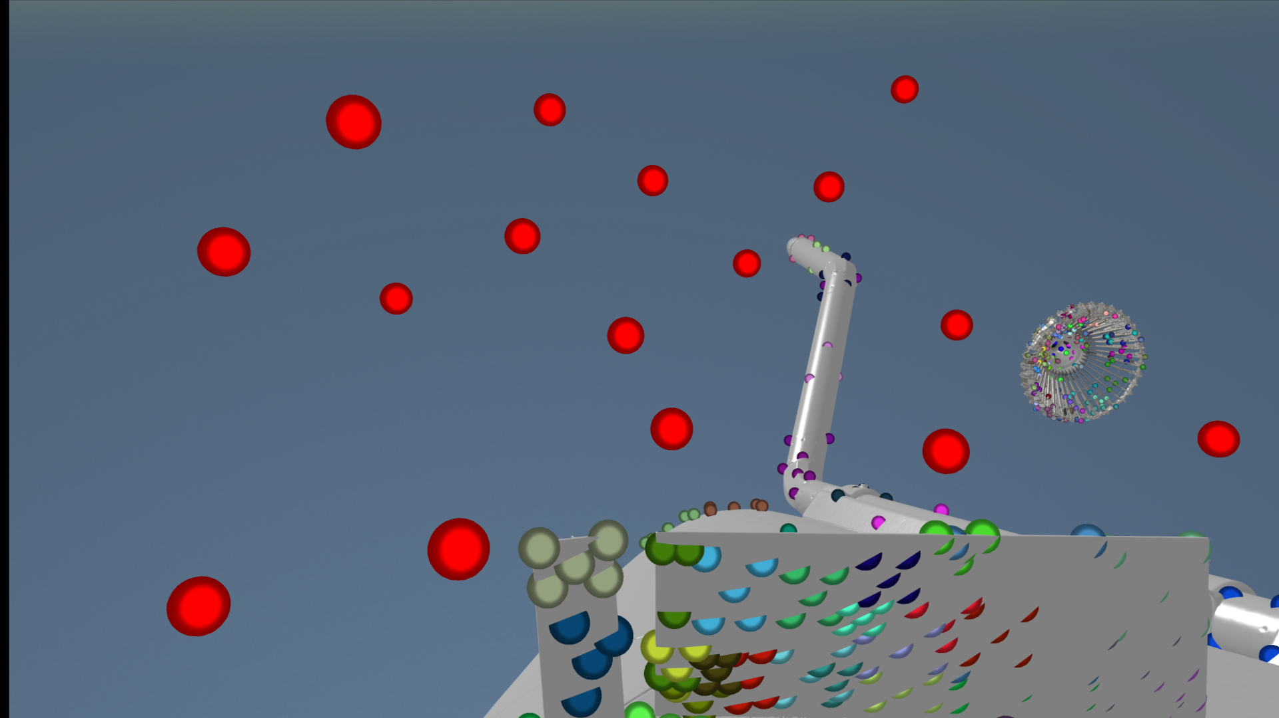

Slide 9
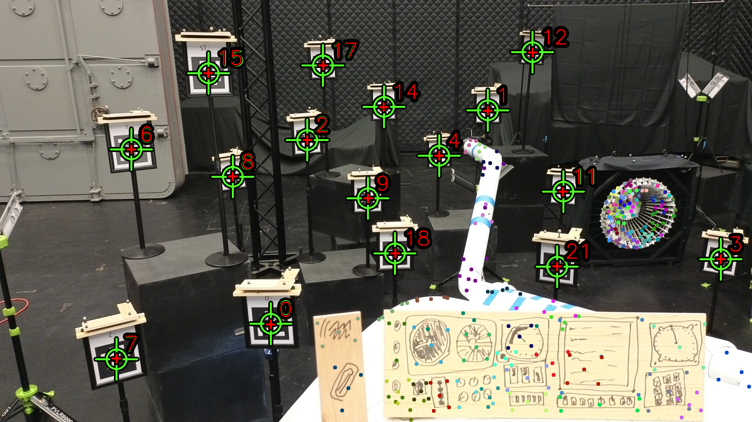

Slide 10
